Slide 1


DATA PROCESSING
WITH MICROSERVICES
Notes:
Integration/batch

Slide 2


MICHAEL MINELLA
Project Lead – Spring Batch
Project Founder/Lead – Spring Cloud Task
Author – Pro Spring Batch
Speaker
JSR-352 Expert Group Member
JavaOne Rockstar
OffHeap Curmudgeon
Twitter - @michaelminella

Slide 3

github.com/mminella/data-microservices

Slide 4

LAY OF THE LAND

Slide 5

SPRING FRAMEWORK

Slide 6

SPRING INTEGRATION

Slide 7

SPRING BATCH

Slide 8

SPRING XD

Slide 9

SPRING CLOUD STREAM

Slide 10
SPRING CLOUD TASK

Slide 11

SPRING CLOUD DATA FLOW

Slide 12

WHAT ARE WE GOING
TO TALK ABOUT?

Slide 13









DATA INTEGRATION

Slide 14

EVOLUTION

Slide 15

MONOLITHS
Notes:
Tight coupling between data models and business logic
Operationally hard to deploy/troubleshoot/etc
Delayed time to market

Slide 16

MULTIPLE INTEGRATION
FLOWS & BATCH JOBS

Slide 17

LARGE COMPLEX
ARTIFACTS

Slide 18

DIFFICULT
TO TEST

Slide 19

HARD TO GET
TO PRODUCTION

Slide 20







BIG DATA
PLATFORMS
Notes:
Apache Flink
Apache Spark
Apache Flume
Apache Sqoop
Apache Oozie

Slide 21

GOOD WITH LARGE
VOLUMES OF DATA

Slide 22

BAD WITH SMALL
VOLUMES OF DATA

Slide 23

LARGE LEARNING
CURVE

Slide 24






LITTLE/NO REUSE
BETWEEN SOLUTIONS

Slide 25

HEAVY FOOTPRINT
IN YOUR CODE

Slide 26

HARD TO TEST

Slide 27

HARD TO GET
TO PRODUCTION

Slide 28

CATEGORY CAN BE USEFUL
JUST NOT FOR EVERYTHING

Slide 29


DATA
MICROSERVICES

Slide 30


CLOUD
NATIVE

Slide 31

DEVELOPED AND TESTED
IN ISOLATION

Slide 32

INDEPENDANTLY
SCALABLE

Slide 33

FAMILIAR DEVELOPMENT
MODEL

Slide 34

SMALL AND SIMPLE
TO TEST

Slide 35

OPERATIONALLY EASY TO
GOVERN

Slide 36

LIKE MINIONS SENT
TO DO YOUR BIDDING

Slide 37

TWO MAIN
PROCESSING MODELS

Slide 38

STREAMS

Slide 39

TASKS

Slide 40

DATA INTEGRATION
AS A SERVICE

Slide 41

COMPOSTION OF
MICROSERVICES

Slide 42
STREAMS AND FLOWS
BECOME YOUR “APP”

Slide 43

OPERATIONAL AND
ORCHESTRATION COVERAGE

Slide 44
SPRING

Slide 45




Spring Cloud
Stream
Spring Cloud
Task
Spring
Batch
Spring
Integration
Spring

Slide 46

SPRING CLOUD
STREAM

Slide 47

MESSAGE
DRIVEN

Slide 48
time
transformer
log

Slide 49
time
transformer
log

Slide 50
@EnableBinding(Source.class)

Slide 51
@EnableBinding(Processor.class)

Slide 52
@EnableBinding(Sink.class)

Slide 53




Slide 54

BATTLE
TESTED

Slide 55
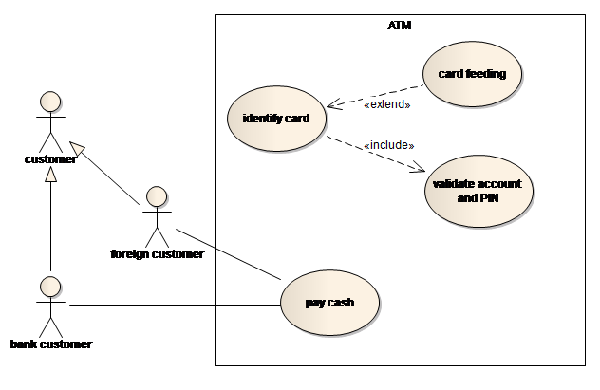
USE CASES

Slide 56
1
DATA INGESTION

Slide 57
2
DATA TRANSFORMATION

Slide 58
3
REAL-TIME
DATA PROCESSING

Slide 59
4
IOT

Slide 60

DEMO
Demo

Slide 61
SPRING CLOUD
TASK

Slide 62

MICROSERVICES
THAT END

Slide 63
1
TASK REPOSITORY

Slide 64
2
BATCH INTEGRATION

Slide 65
3
STREAM INTEGRATION

Slide 66
@EnableTask

Slide 68
BATTLE
TESTED

Slide 69
USE CASES

Slide 70
1
BATCH JOBS

Slide 71
2
ONE OFF PROCESSES
Notes:
Database migratioins

Slide 72
3
ETL PROCESSES

Slide 73
4
FINITE PROCESSING

Slide 74
5
DATA SCIENCE

Slide 75

DEMO
Demo

Slide 76
SPRING CLOUD
DATA FLOW

Slide 77

SPRING XD

Slide 78

TAKES ADVANTAGE OF
MODERN PLATFORMS

Slide 79
1
CLOUDFOUNDRY

Slide 80
2
KUBERNETES

Slide 81
5
LOCAL

Slide 82
WHAT IS
SPRING CLOUD DATA FLOW?

Slide 83

DATA FLOW
ORCHESTRATES

Slide 84
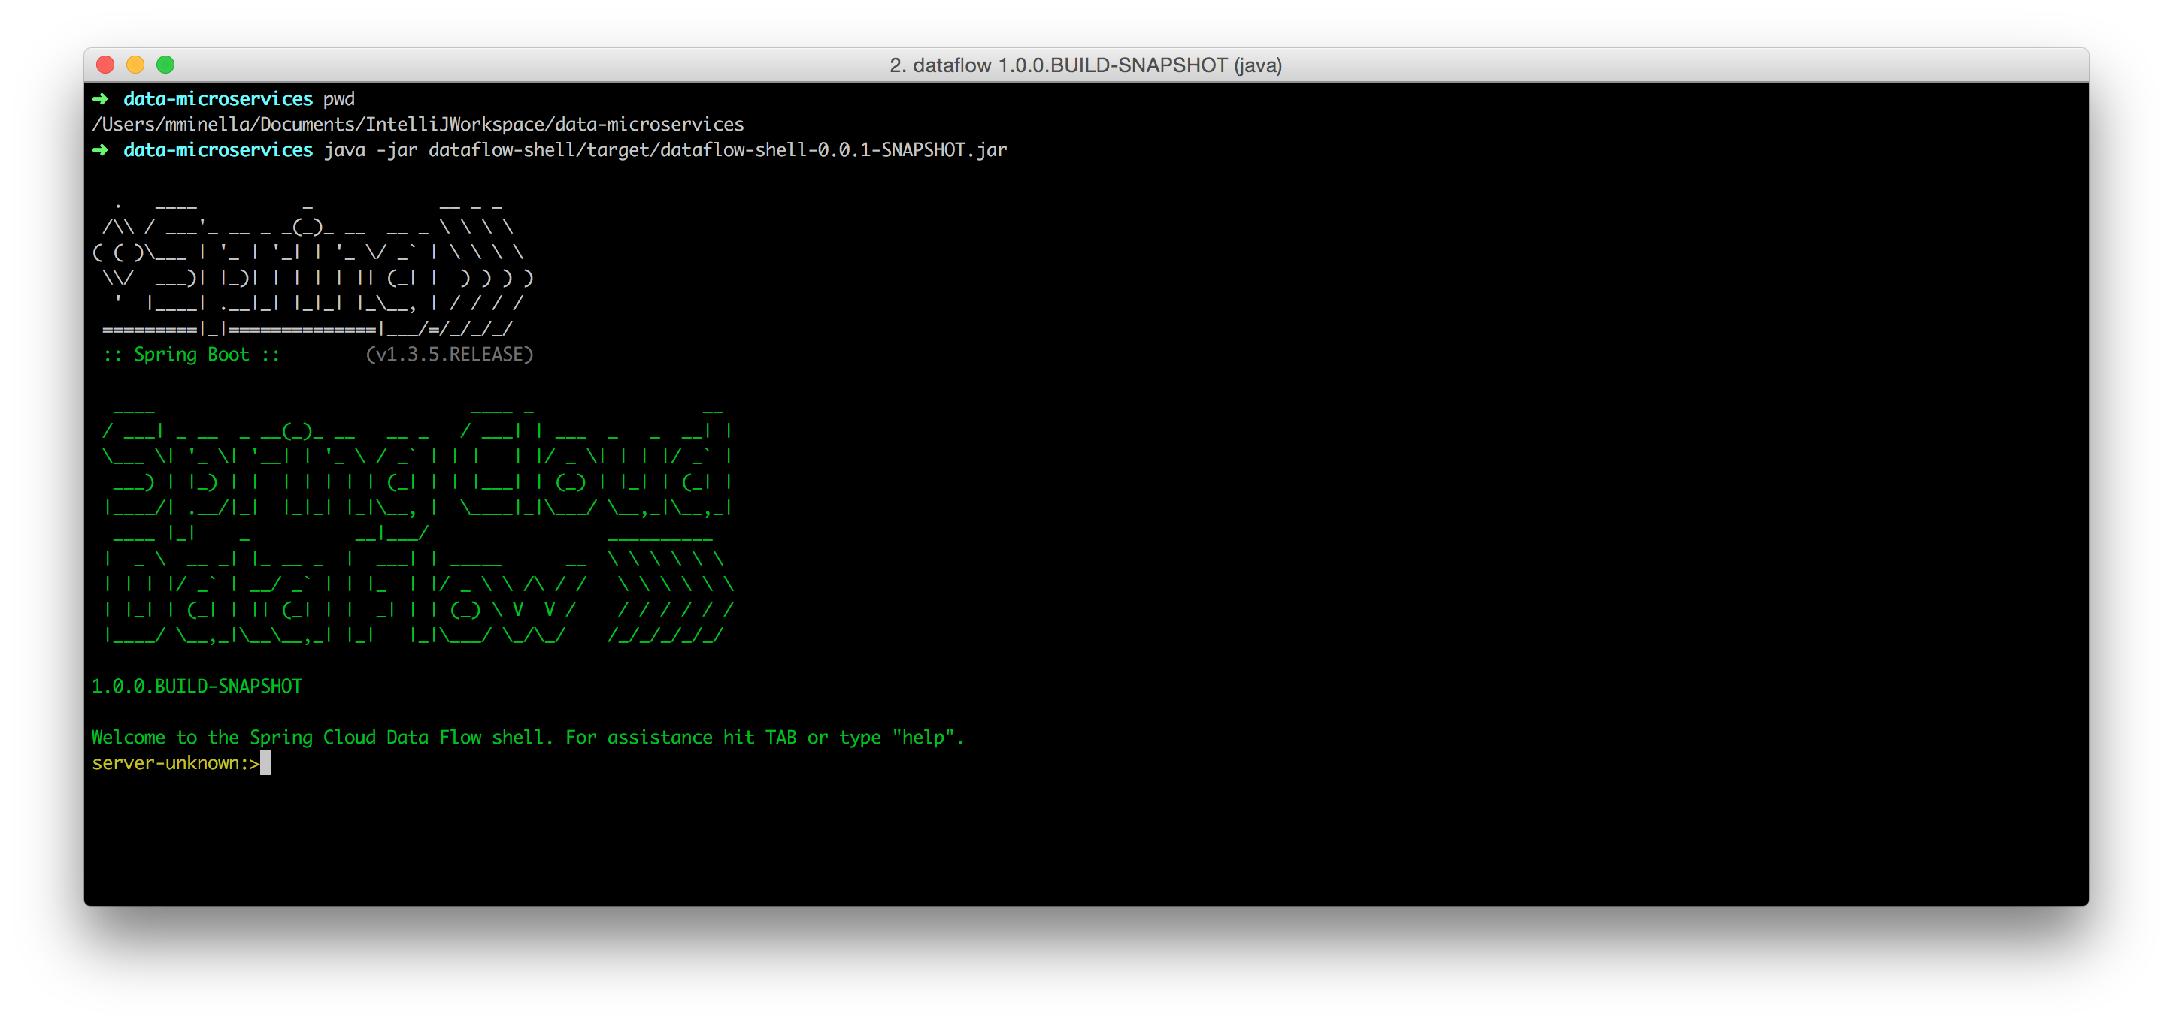


Slide 85
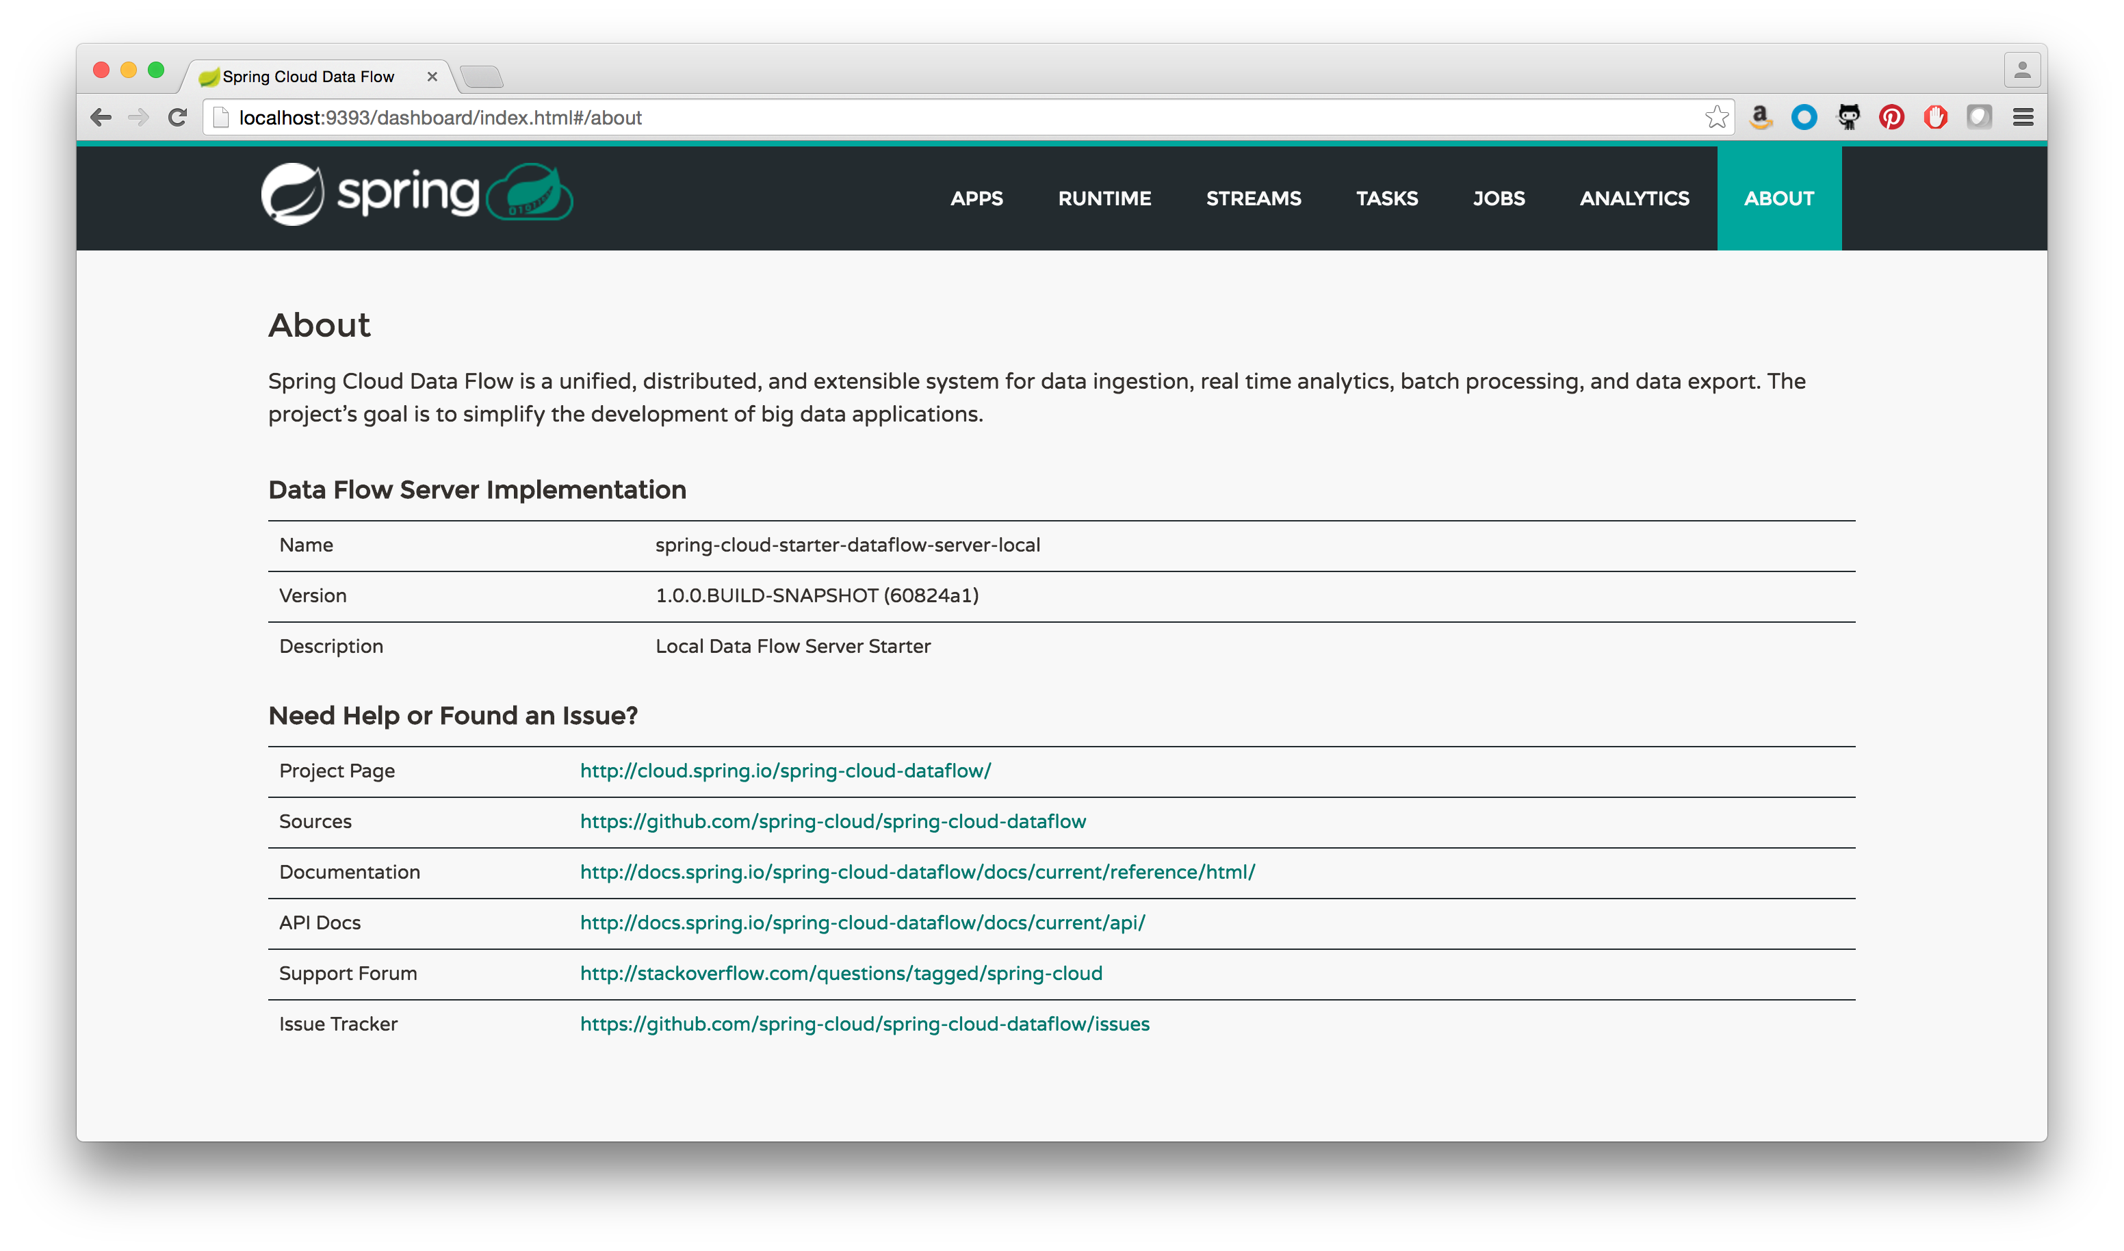

Slide 86
// DSL
http | filter | hdfs

Slide 87
// DSL
http | filter | hdfs

Slide 88

NO INSTALLED
CONTAINERS

Slide 89

EVERYTHING IS
SPRING BOOT

Slide 90
A BOOT APP FOR
THE SERVER

Slide 91
A BOOT APP FOR
THE SHELL

Slide 92
ALL BOOT APPS
FOR OTB APPS

Slide 93
app
app
app
Data Flow Server
shell
browser

Slide 94
twitter
file
field-value-counter
Data Flow Server
shell
browser

Slide 95
twitter
file
field-value-counter

Slide 96

DEMO
Stream Demo

Slide 97

BUT WAIT,
THERE’S MORE!

Slide 98
1
TASK/STREAM/BATCH
INTEGRATION

Slide 99
2
PARTITIONED STREAMS

Slide 100
3
SCALING
STREAMS & TASKS

Slide 101

CURRENT
STATE

Slide 102
SPRING STREAM

Slide 103
CHELSEA SR2 CURRENT

Slide 104
DITMARS THIS YEAR

Slide 105
SPRING TASK

Slide 106
1.2.0.RELEASE CURRENT

Slide 107
1.3.0.RELEASE IN Q4

Slide 108
SPRING DATA FLOW

Slide 109
1.2.0.RELEASE CURRENT

Slide 110
2.0.0.RELEASE IN Q4

Slide 111

Learn More. Stay Connected.
Pivotal: pivotal.io
Twitter: twitter.com/springcentral
YouTube: spring.io/video
LinkedIn: spring.io/linkedin
Google Plus: spring.io/gplus
Spring Cloud Data Flow
Project: cloud.spring.io/spring-cloud-dataflow/
Github: github.com/spring-cloud/spring-cloud-dataflow
Spring Cloud Stream
Project: cloud.spring.io/spring-cloud-stream/
Github: github.com/spring-cloud/spring-cloud-stream
Spring Cloud Task
Project: cloud.spring.io/spring-cloud-task/
Github: github.com/spring-cloud/spring-cloud-task

Slide 112

QUESTIONS?

Slide 113

The
End

Slide 114

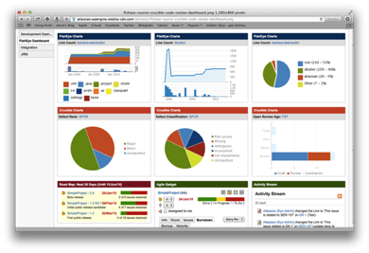





Ingestion
Orchestration
SPRING
Extraction
Real-time
Analytics
Notes:
Spring XD handles everything in the circle

Slide 115


&
STREAMING
BATCH

Slide 116







Notes:
https://commons.wikimedia.org/wiki/File:Human_evolution.svg

Slide 117
